Slide 1
CSE231 – Digital Logic Design
Flip-Flops and Registers

Slide 2
Basic Memory Elements

Slide 3
Basic Memory Elements
Basic Latch
  A feedback connection of two NOR gates or two NAND gates, which can store one bit of information.
    Can be set to 1 or reset to 0.
Gated Latch
  A basic latch that also includes input gating and a control input signal (i.e. the clock).
Flip-Flop
  A storage element based on the gated latch principle, which can have its output state changed only on the edge of the controlling clock signal.

Slide 4
D Flip-Flop

Slide 5
D Flip-Flop
Master-Slave Flip-Flop

Slide 6
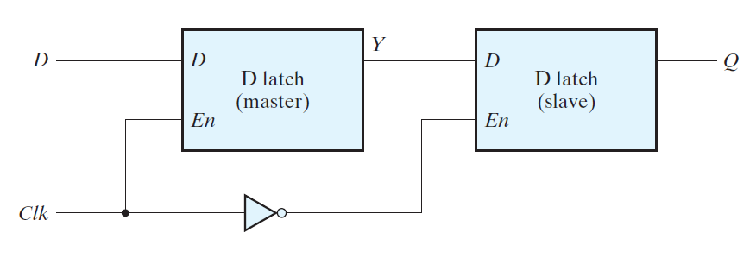
D Flip-Flop: Master-Slave

Slide 7
D Flip-Flop
Positive Edge-triggered Flip-Flop

Slide 8
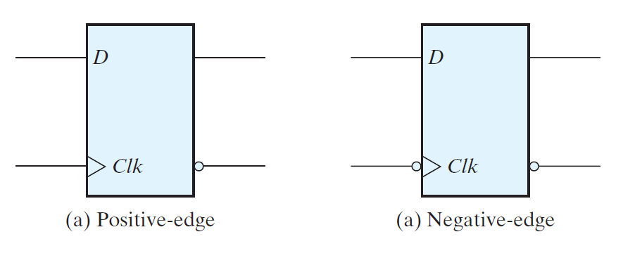
D Flip-Flop: Symbols

Slide 9
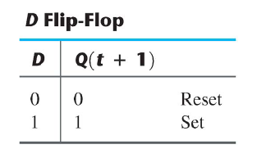
D Flip-Flop: Function Table

Slide 10
Basic Memory Elements
Comparison of
Level-Sensitive and Edge-Triggered
Memory Elements

Slide 11
D
D
Q
Q
a
Gated D Latch
Clock
Clk
Q
Q
a
Note that the Latch,
Positive Edge-triggered FF,
and Negative Edge-triggered FF
each have a unique symbol
D
Q
Q
b
Positive Edge-triggered
D Flip-Flop
Q
Q
b
D
Q
Q
c
Negative Edge-triggered
D Flip-Flop
Q
Q
c
(a) Circuit
Clock
D
Q
Gated D Latch
a
Q
+ Edge-triggered D FF
b
Q
- Edge-triggered D FF
c
(b) Timing diagram

Slide 12
Flip-Flops
Asynchronous Preset and Clear Signals

Slide 13
Asynchronous Preset and Clear
Preset
D
Q
Clock
Q
Clear
(a) Circuit
master
slave
Preset
D
Q
Q
Clear
(b) Graphical symbol

Slide 14
Flip-Flops
JK Flip-Flop

Slide 15
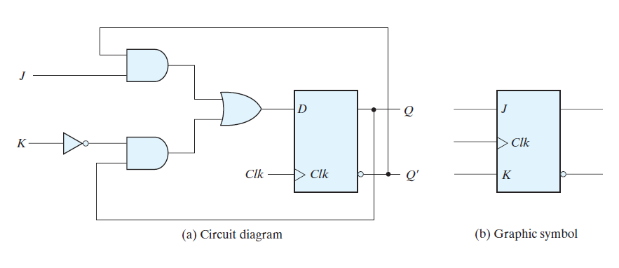
JK Flip-Flop

Slide 16
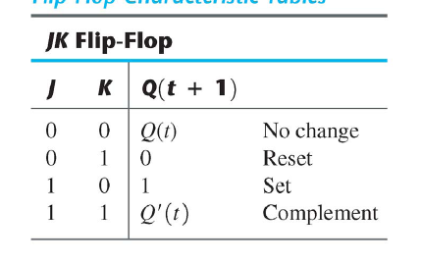
JK Flip-Flop

Slide 17
Flip-Flops
T Flip-Flop

Slide 18
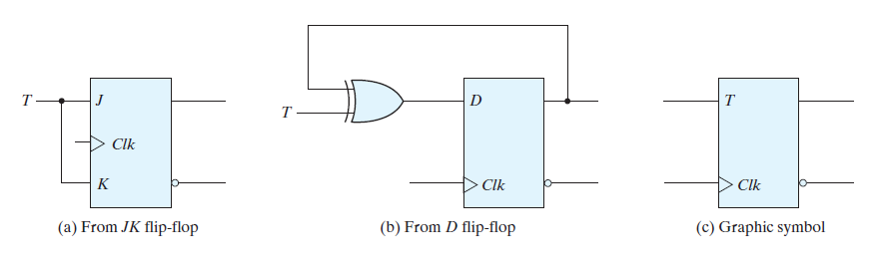
T Flip-Flop

Slide 19
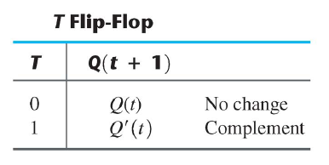
T Flip-Flop

Slide 20
Registers

Slide 21
Registers
Register
  Consists of N Flip-Flops
  Stores N bits
  Common clock used for all Flip-Flops
Shift Register
  A register that provides the ability to shift its contents (either left or right).
  Must use Flip-Flops
    Either edge-triggered or master-slave
  Cannot use Level-sensitive Gated Latches

Slide 22
Registers
4-bit Register

Slide 23
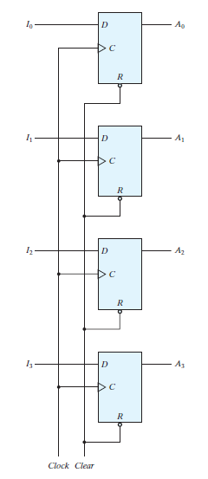

Slide 24
Registers
4-bit Register with Parallel Load

Slide 25
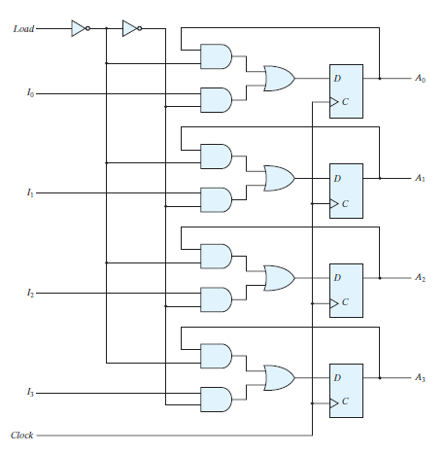
2-to-1 Multiplexer

Slide 26
Registers
4-bit Serial-In Serial-Out
Shift Register

Slide 27
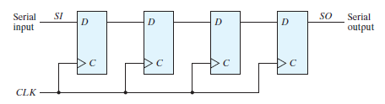
4-bit SI/SO Shift Register
common clock
Edge-triggered
Flip-Flop

Slide 28
Registers
Parallel-In Parallel-Out
Shift Register

Slide 29
Registers
Parallel-In Parallel-Out
Bi-directional Shift Register

Slide 30
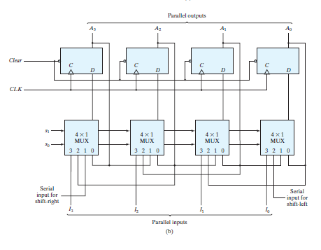
4-bit PI/PO Bi-directional
Shift Register

